Slide 1
Procedures for
Drug and Alcohol Testing
For Food Services Staff

Slide 2
Overview
This Training will provide attendees with the knowledge to understand the drug and alcohol testing processes and requirements. This training will address the following areas:
Drug, Alcohol, and Tobacco-Free Workplace Bulletin (6488.2).
What are the employees’ responsibilities.
What are the supervisors’ responsibilities.
Drug and Alcohol Testing procedure and disciplinary process.
What are the steps in the Drug and Alcohol Testing process.
Reasonable Suspicion.

Slide 3
Purpose and Benefits
Promote Awareness
Ensure that all District Employees and Volunteers are aware of expectations when dealing with incidents relating to drug and/or alcohol.
Ensure a Healthy and Safe Working Environment
The District is required to provide a drug free workplace and to foster an effective learning and working environment for students and staff.

Slide 4
Goal
Ensure all District Employees know and understand the District Policies, its responsibility to provide a drug and alcohol-free environment to staff and students and the implications for the district and its staff and students should we fail to enforce this policy.
Ensure that all District Employees understand the procedures required and in place to address drug and/or alcohol incidents.
Ensure that all District Employees understand the consequences for infractions such as being under the effects of drug and/or alcohol.

Slide 5
Drug, Alcohol, and Tobacco-Free Workplace Bulletin (6488.2)
Under the Drug-Free Workplace Act of 1988, and Safe and Drug-Free Schools and Communities Act, the district must meet certain drug-free workplace and school requirements in order to receive federal contracts, funds, or grants. Specifically, employees must be notified that the unlawful manufacture, distribution, dispensation, possession, or use a controlled substance is prohibited in the employee’s workplace.
In accordance with the provisions of these legislative mandates, the district hereby notifies its employee of its commitment to promote and maintain a workplace and school environment that Is drug. alcohol, and tobacco-free.

Slide 6
Drug, Alcohol, and Tobacco-Free Workplace Bulletin (6488.2)
The district shall notify federal agencies with whom contracts are held or from whom grants are received within 10 days of receiving notice that an employee, in a position funded in whole or in part by such contract or grant, has been convicted of a criminal drug statute for violation occurring in the workplace. In addition, certification will be sent to the federal granting or funding agencies that the district has complied with and will remain in compliance with the requirements of the Drug-Free Workplace Act.

Slide 7
Effects of Drug/Alcohol
Abuse
Learning difficulty and lack of memory.
Apathy/Loss of concentration.
Slow reactions/poor coordination.
Refusal to accept authority.
Delayed decision making/confusion.
Sleeping on the job.

Slide 8
Effects of Drug/Alcohol
Abuse
Increased accidents or near misses.
Absenteeism or tardiness.
Low productivity and poor work quality.
Low morale, problems working with others.
Theft.
Transferring to avoid detection.

Slide 9
Employee Responsibilities
Report to work without drugs, including marijuana or alcohol in his/her system.
Be able to perform his/her job duties without impairment due to the use of drugs or alcohol when on duty or subject to duty.
Not possess, manufacture, sell or distribute drugs in the workplace.
Submit immediately to a drug or alcohol test when ordered by a supervisor, manager or other district designated representative.
Employees are required to report any criminal drug or alcohol statute convictions for a violation occurring in the workplace no later than five (5) days after a conviction.
Employees convicted of a criminal drug offense for illegal drug or alcohol
activity may be subject to appropriate discipline, up to and including dismissal.
Note: The district policy in no way precludes administrative or disciplinary
action by the district for drug or alcohol related violation that occur outside the workplace.

Slide 10
Supervisor Responsibilities
Supervisors will inform all employees of this policy and post a copy of “Notice to all Employees: Drug-Free and Alcohol-Free Workplace” at every work location in the district. All persons hired shall be provided a copy of this notice as part of their processing for employment. Employee acknowledgement of receipt of this notice shall be filed in the employee’s personnel folder.
If a supervisor has reasonable suspicion that an employee is under the influence while at work, the supervisor will inform the employee of his/her reasonable suspicion and direct the employee to take a drug and alcohol test as a condition of employment. Failure of a supervisor to implement/enforce this policy may result in discipline for the supervisor.

Slide 11
Supervisor Responsibilities
Supervisors are expected to encourage employees and family members who need assistance in these areas to use one of the district provided health insurance plans, as appropriate.
Supervisory personnel are further responsible for informing visitors and staff about this tobacco-free workplace policy by ensuring that the “Notice to all Employees: Tobacco-Free Schools’ is prominently posted. All persons hired after the date of this bulletin shall be provided a copy of the “Notice to all Employees Tobacco-Free Schools” as part of their processing for employment.

Slide 12
District’s Zero Tolerance
Policy
The policy if the district is to maintain a drug, alcohol, and tobacco-free workplace and prohibit the manufacture, sale, distribution, dispensing, possession, or use of illicit drugs, electronic devices such as electronic cigarettes and alcohol by employees at all workplaces.
It is also the policy of the district to prohibit smoking and the use of all tobacco products, such as cigarettes and paraphernalia, at all times, on all district property (district-owned or leased buildings) and in district vehicles, by all persons, including employees, students and visitors at any school or district site or at any school sponsored event.
The policy prohibits employees from appearing for work under the influence of a prohibited substance. In addition, all District Employees who may be required to operate a commercial motor vehicle are subject to all U.S. Department of Transportation drug and alcohol testing programs, regulations, and procedures.

Slide 13
District’s Zero Tolerance
Policy
Violation of the District Policy by any employee will result in appropriate administrative or disciplinary action, including, but not limited to:
Written reprimand.
Suspension.
Termination.
Requirement for satisfactory participation and completion of a drug and/or alcohol-abuse assistance or rehabilitation program.

Slide 14
Drug and Alcohol Procedure
Reasonable Suspicion must be established.
Two supervisory employees must observe the employee.
FSM and AFSS
FSM and School Administrator
Two AFSS
AFSS and School Administrator or Senior HR Representative
Note: Both employees must agree that the individual is under the effects od drugs and/or alcohol (Please refer to the Substance Use/Abuse Detention Worksheet).
The Substance Use/Abuse Detection Worksheet must be completed to
Document the employee’s behavior that establishes reasonable suspicion.
AFSS is responsible for coordinating the D/A screen and the determination to test.

Slide 15
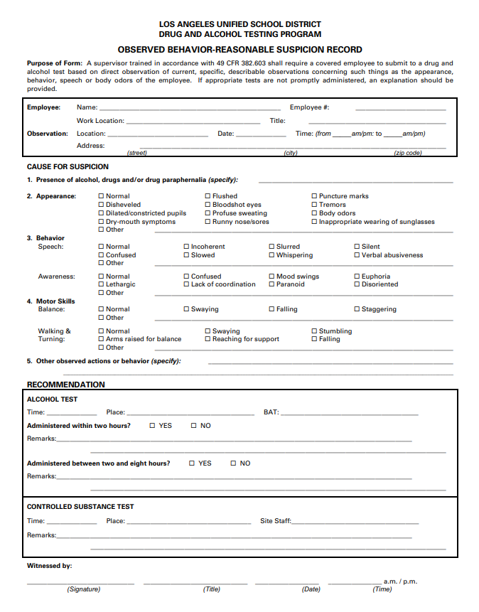
Observed
Behavior-Reasonable
Suspicion Record

Slide 16
Observed
Behavior-Reasonable
Suspicion Record

Slide 17
Observed
Behavior-Reasonable
Suspicion Record

Slide 18
Drug and Alcohol Procedure
Reasonable Suspicion must be established.
If you suspect that an employee has appeared for work under the effects of drugs or alcohol:
Contact your AFSS/HR Representative immediately.
FSM and the AFSS/HR Representative or School Administrator should meet with the employee to verify suspicions:
Express concern for his/her condition and describe observations that have led you to believe that he/she has been drinking or has taken something that has affected his/her condition.
Once it’s determined the employee is to be tested, the AFSS must contact the FSD HR Department, Regional Manager, or Deputy Director.
The designated FSD Administrator will contact a taxi company and medical office to make arrangements for the employee to be driven to the medical office for testing.
The FSD requires that employees are given a breath alcohol and urine test.

Slide 19
Drug and Alcohol Procedure
Reasonable Suspicion must be established.
If you suspect that an employee has appeared for work under the effects of drugs or alcohol:
If the employee refuses, explain refusal to test will subject the employee to immediate suspension pending dismissal.
Do not attempt to stop/restrain the employee.
If the employee leaves the school, you may contact the police to inform them of possible endangerment to the public as the employee is potentially driving under the influence.
If the employee agrees to be tested, wait until the taxi arrives, ensure employee rides in cab by himself/herself.
The AFSS must follow taxi to the clinic in their own vehicle.
The AFSS must wait for the test to be administered, and forward confirmation of test being performed to HR.

Slide 20
What Drugs Does the
District Test For?
Marijuana
Opiates (Including Heroin)
Cocaine
Phencyclidine (PCP)
Amphetamines
Note: Labs will also test to determine if certain adulterants or foreign
substances have been added to the urine, or if the urine has been diluted or substituted.

Slide 21
Drug and Alcohol Procedure
Reasonable Suspicion must be established.
Strict confidentiality must be maintained regarding the employee being asked to test and any test results.
Contact FSD HR Unit for further instructions regarding disciplinary action to follow.
Employee should be directed to wait for instructions from the HR Unit prior to returning to work.
If an employee refuses to test, fails to submit enough of the substance to obtain a test, it is treated as a positive test.
A positive is grounds for dismissal.
Under certain circumstances, the district may allow for lesser discipline, however this will be decided on a case-by-case basis.

Slide 22
What to do if you Suspect
Someone is Under the
Influence
If you observe an employee that exhibits any of the behavior described in the presentation:
Call your AFSS/HR Representative immediately. Call the Central Office at 333 S. Beaudry at (213)241-2993 or (213)241-1745. Do not stop calling until you contact someone.
Do not send them home. It is your responsibility as a supervisor to enforce the District Zero Tolerance Policy for drugs and alcohol in the workplace.
Inform the employee if he/she leaves, or fails to take the test, it will be treated as a positive, and the Division will move for his/her dismissal.

Slide 23
Employees are Responsible
For Keeping LAUSD a Safe
Working Environment
Employees should know and understand the Drug, Alcohol, and Tobacco-Free Policy:
Understand the affects of alcohol/drug use.
Be able to identify signs of reasonable suspicion.
Have knowledge of what Food Services Division’s procedures are regarding drugs and alcohol.
Understanding your role in the FSD Drug and Alcohol Procedure.

Slide 24
References
Procedures for Drug and Alcohol Testing for Food Services Staff
Drug and Alcohol Testing Notification and Authorization Form
Drug and Alcohol, Tobacco-Free Workplace Bulletin BUL-6488.2
Drug and Alcohol Testing Program Post Accident Log
Food Services Division Employee Handbook
Observed Behavior-Reasonable Suspicion Record

Slide 25
Questions?
Procedures for Drug and Alcohol Testing for Food Services Staff

Slide 26
We appreciate you
keeping our schools safe.

